Slide 1
Image Variation and Generation
using Alpha-CLIP and Diffusion Models
409410117 資工四 蔡維彬
409410090 資工四 李明翰

Slide 2
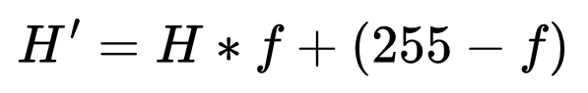
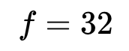
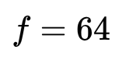
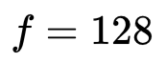
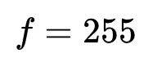




Goal
Compare CLIP and Alpha-CLIP on image variation and generation
Test the benefits of using Alpha-CLIP on a variety of images
Replace binary mask with grayscale mask and a focus scale parameter

Slide 3
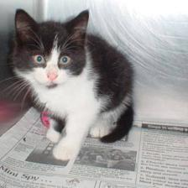

Image Variation: Alpha-CLIP + Stable Diffusion
text
encoder
UNet
image decoder
A tuxedo cat
image
encoder
UNet
image decoder

Slide 4
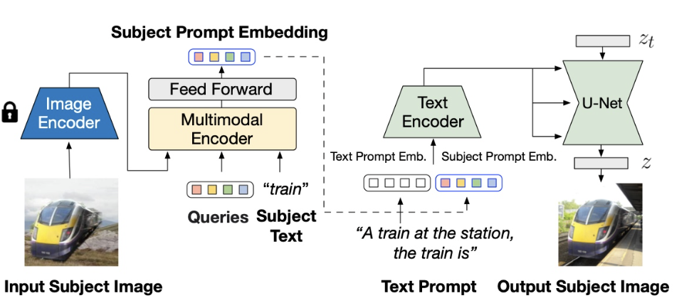
Subject-driven Image Generation: Alpha-CLIP + BLIP-Diffusion
sgt prompt
image
encoder
UNet
image
encoder

Slide 5
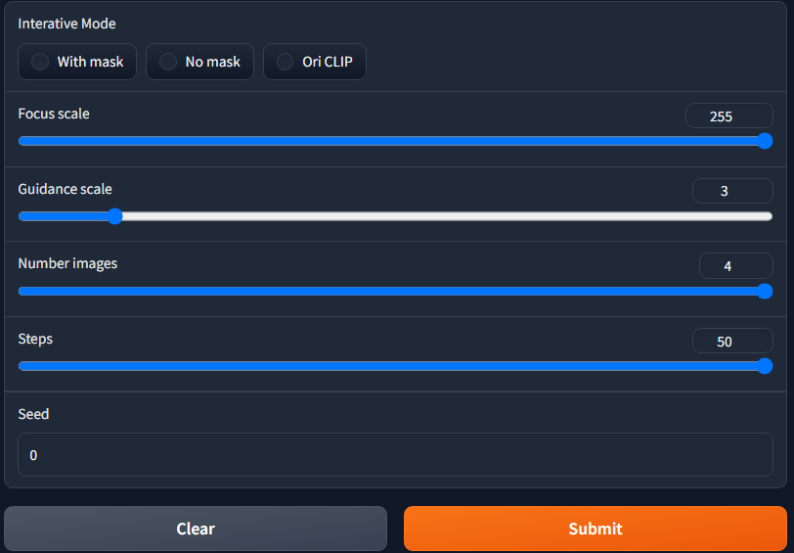
Experiment Settings: Image Variation
Orignal CLIP
Alpha-CLIP with global and local mask
Focus scale: 255
Guidance Scale: 3
Steps: 50

Slide 6
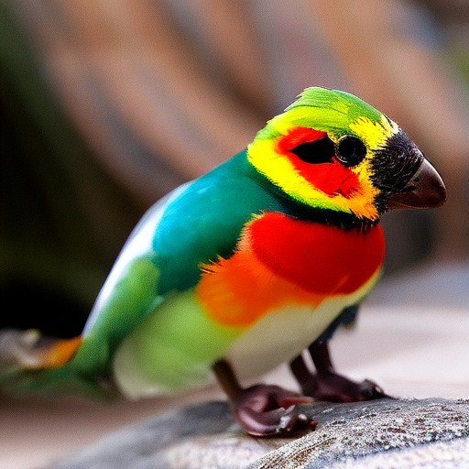
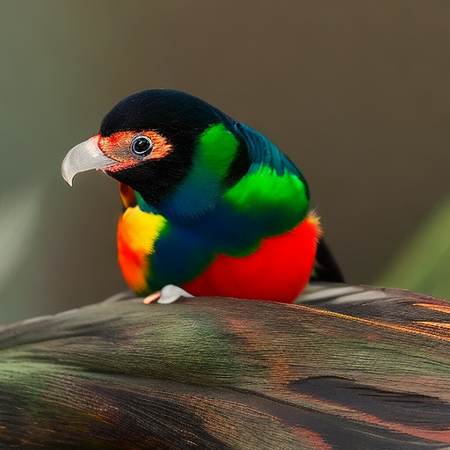
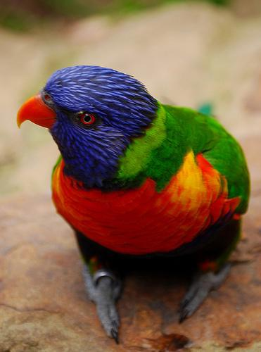
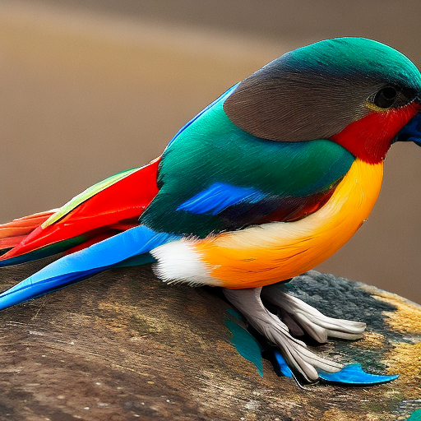
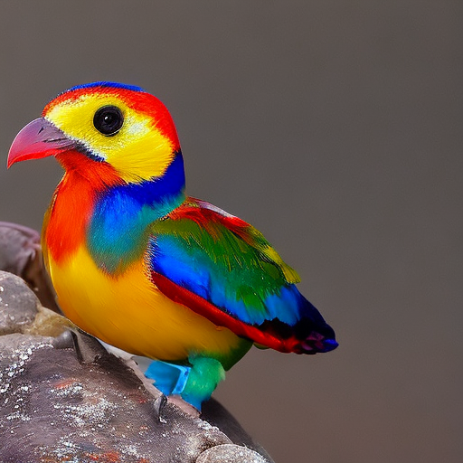
Single Object, CLIP

Slide 7
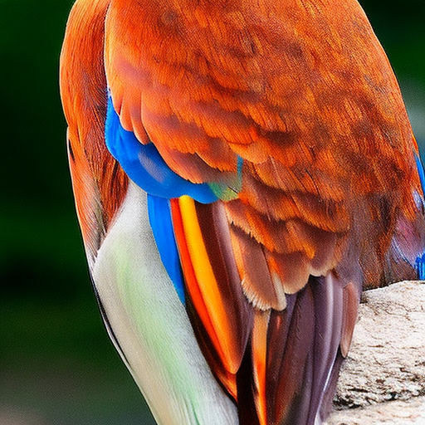
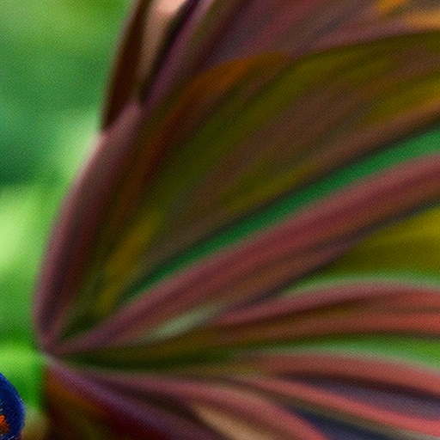
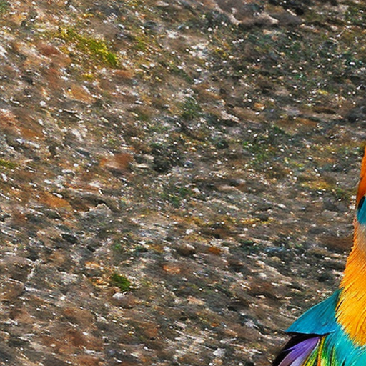
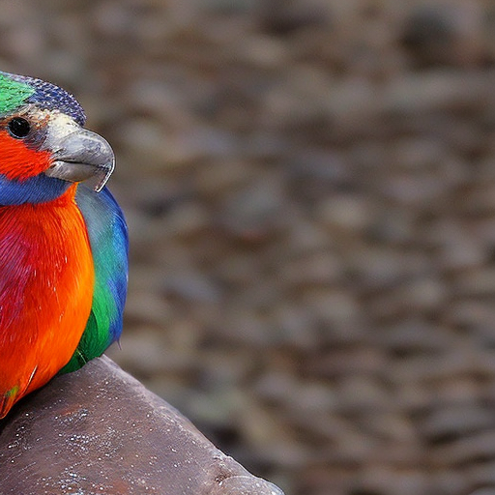
Single Object, Global Alpha-CLIP

Slide 8
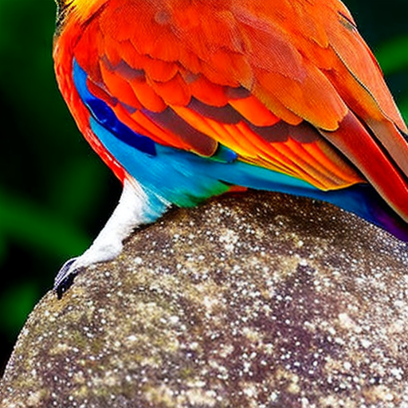
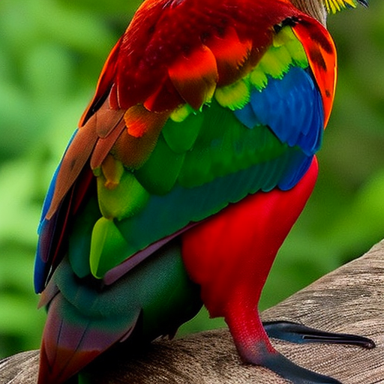
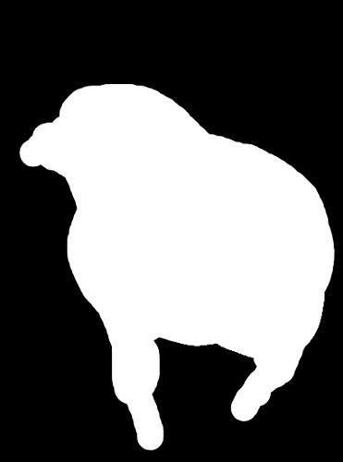
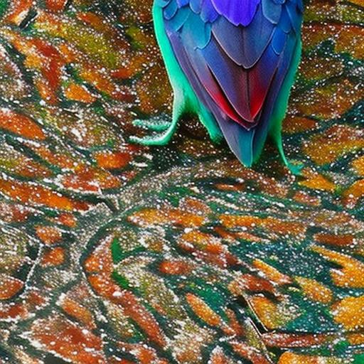
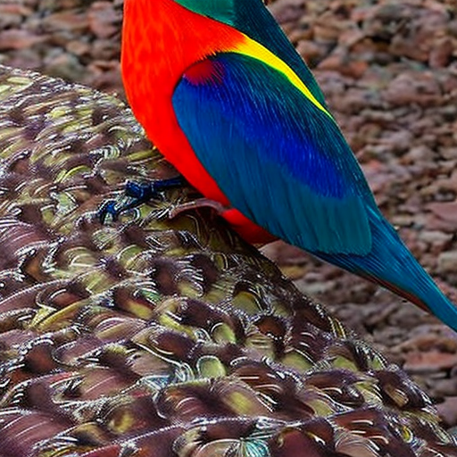
Single Object, Local Alpha-CLIP

Slide 9
Comparison
Cropped due to resizing
Original
CLIP
Global Alpha-CLIP
Local Alpha-CLIP

Slide 10
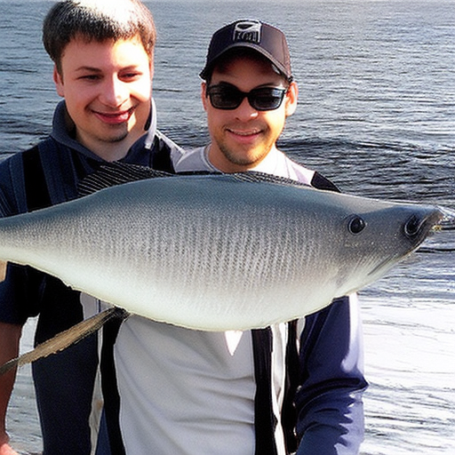
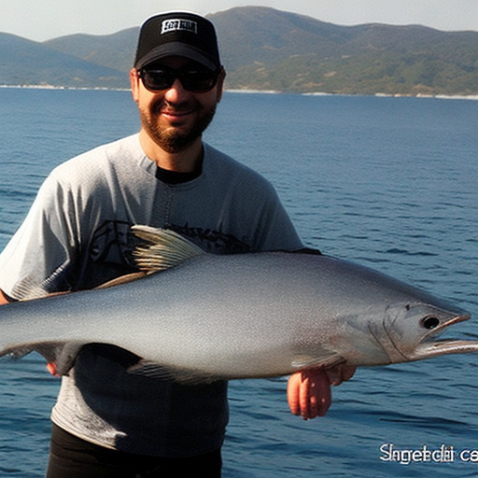
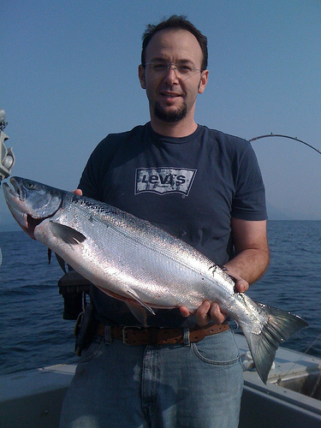
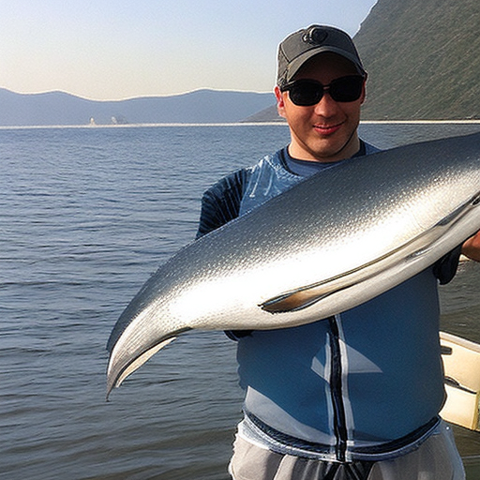
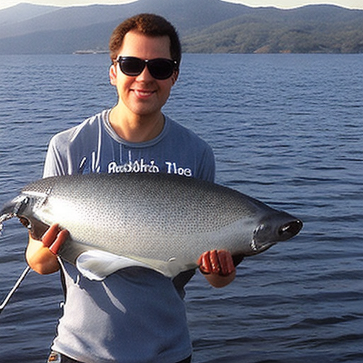
Two Objects ,CLIP

Slide 11
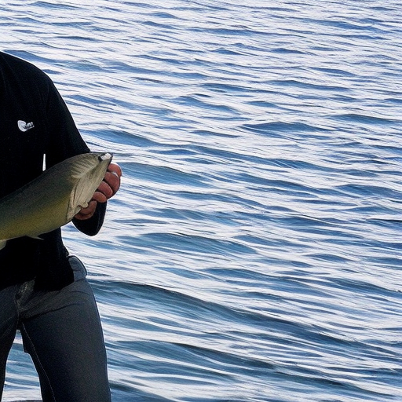
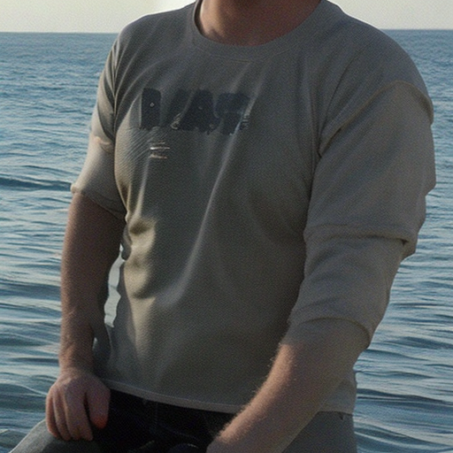

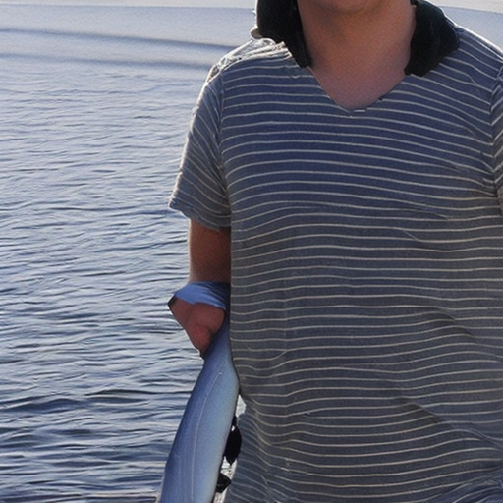
Two Object, Global Alpha-CLIP

Slide 12
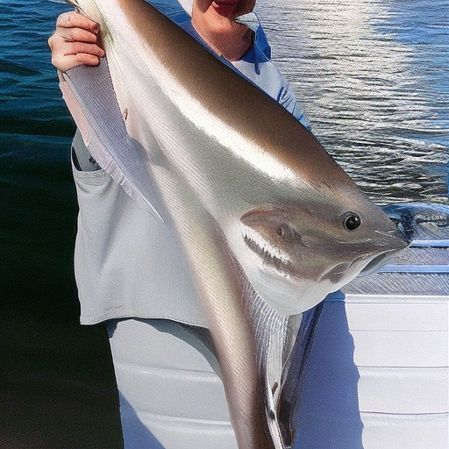
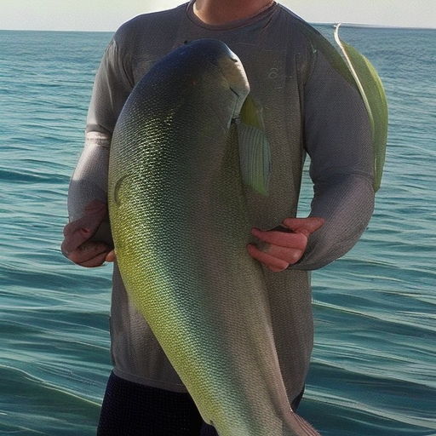

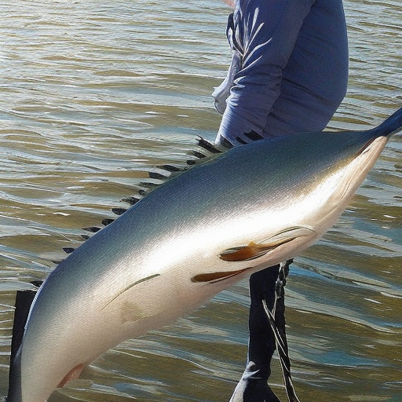
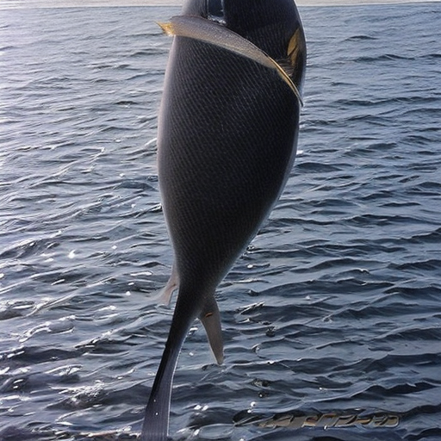
Two Objects, Local Alpha-CLIP

Slide 13
Comparison
Failed to locate object
Distortion
Original
CLIP
Global Alpha-CLIP
Local Alpha-CLIP

Slide 14
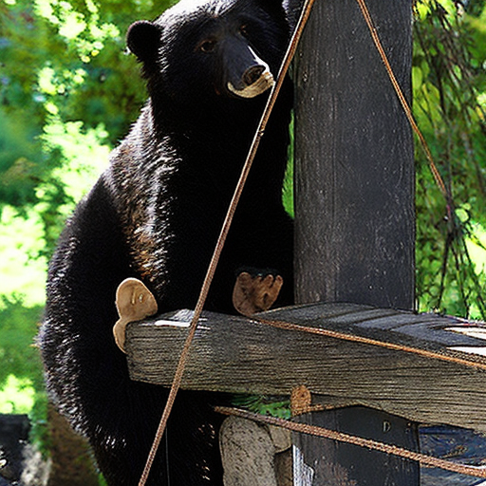
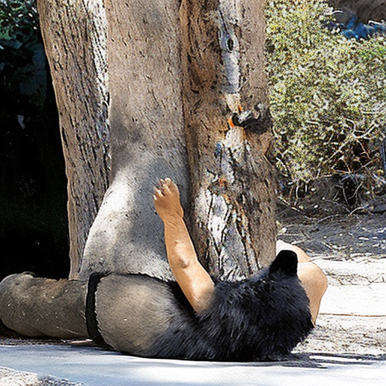
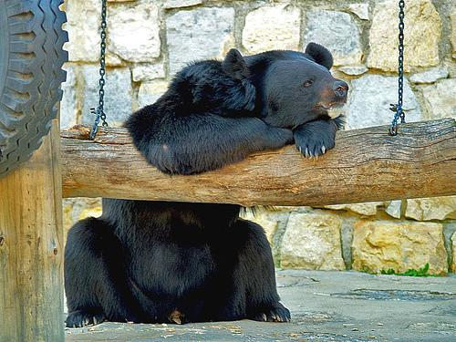
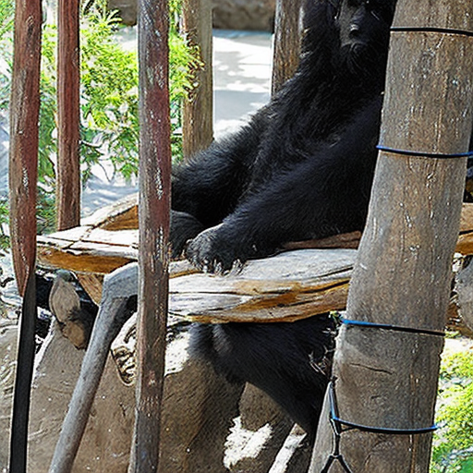
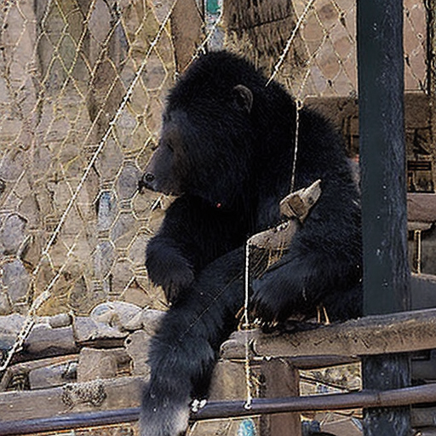
Divided Object, CLIP

Slide 15
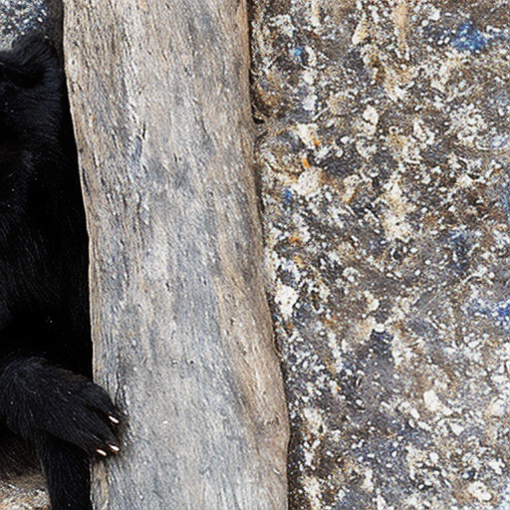
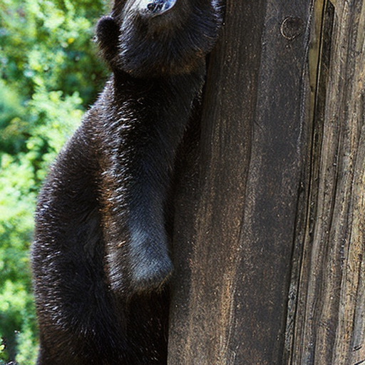
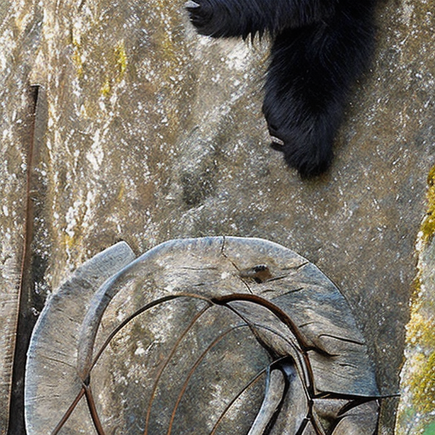
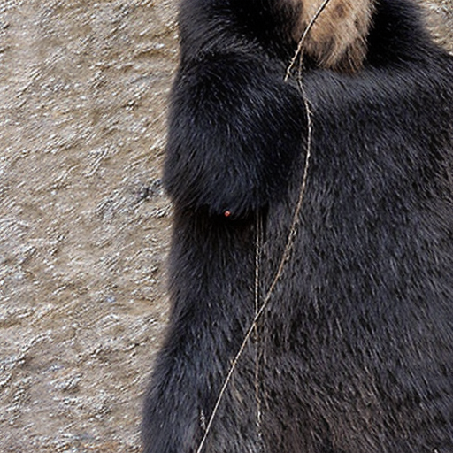
Divided Object, Global Alpha-CLIP

Slide 16
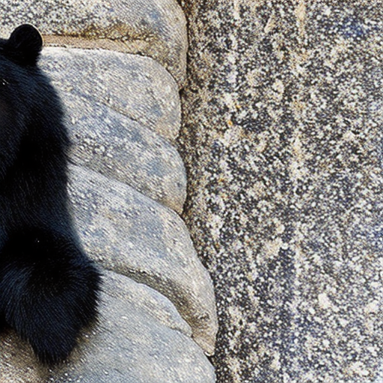
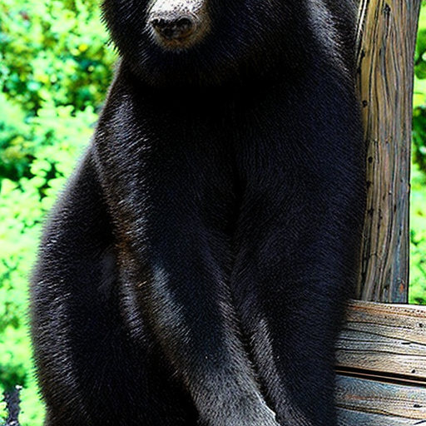
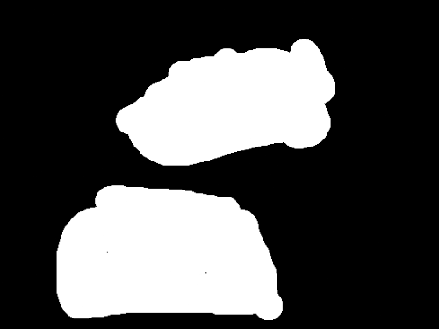
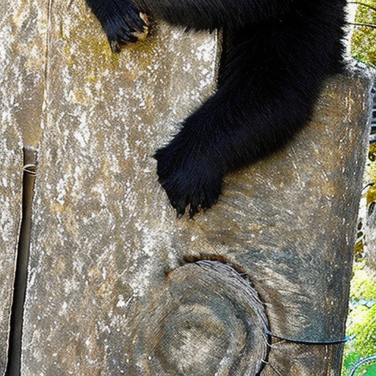
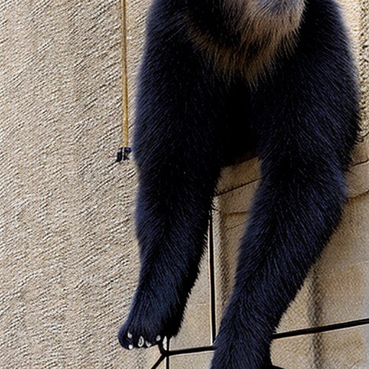
Divided Object, Local Alpha-CLIP

Slide 17
Comparison
Object shifting
Original
CLIP
Global Alpha-CLIP
Local Alpha-CLIP

Slide 18
Conclusion
CLIP outperforms Alpha-CLIP using image encoder only
The aspect ratio and size of the object matter
Global mask is too “global”

Slide 19
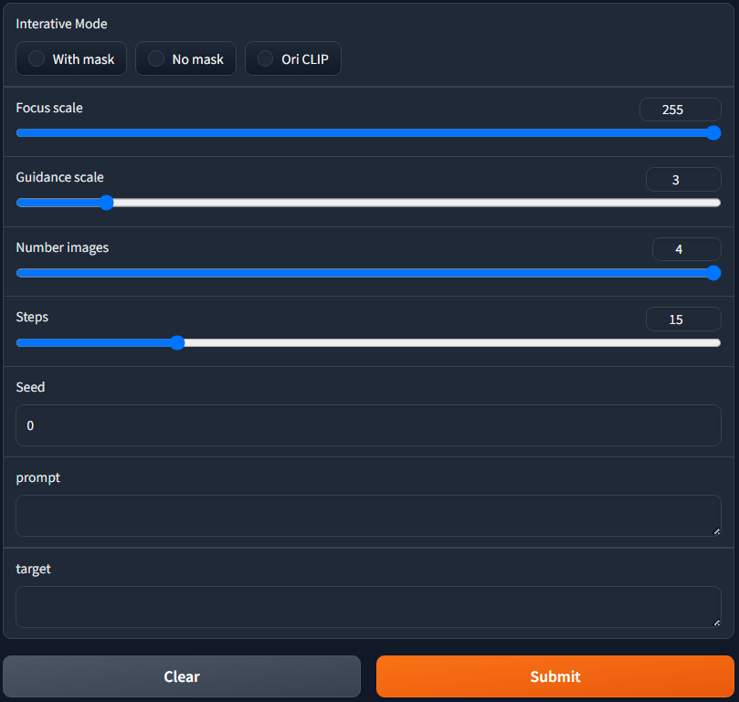
Experiment Settings: Subject-driven Image Generation
CLIP
Alpha-CLIP with global and local mask
Focus scale: 64, 128, 255
Guidance scale: 3
Steps: 15

Slide 20
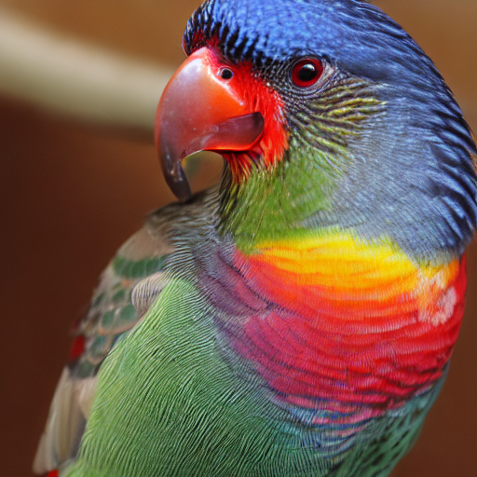



Single Object, CLIP

Slide 21




Single Object, Global Alpha-CLIP

Slide 22





Single Object, Local Alpha-CLIP

Slide 23
Comparison
Better diversity
Original
CLIP
Global Alpha-CLIP
Local Alpha-CLIP

Slide 24




Two Objects, CLIP

Slide 25




Two Objects, Alpha-CLIP, F = 0

Slide 26





Two Objects, Alpha-CLIP, Focus Scale = 64

Slide 27





Two Objects, Alpha-CLIP, F = 128

Slide 28





Two Objects, Alpha-CLIP, F = 255

Slide 29
Comparison
Extra fingers
Keep prominent patterns
Higher F -> fine-grained
Original
CLIP
Alpha-CLIP, F = 0
Alpha-CLIP, F = 64
Alpha-CLIP, F = 128
Alpha-CLIP, F = 256

Slide 30





Mutiple Objects, CLIP

Slide 31




Mutiple Objects, Alpha-CLIP, F = 0

Slide 32





Mutiple Objects, Alpha-CLIP, F = 64

Slide 33




Mutiple Objects, Alpha-CLIP, F = 127

Slide 34





Mutiple Objects, Alpha-CLIP, F = 255

Slide 35
Comparison
Hard to distinguish multiple small objects
Grayscale?
Original
CLIP
Alpha-CLIP, F = 0
Alpha-CLIP, F = 64
Alpha-CLIP, F = 128
Alpha-CLIP, F = 256

Slide 36
Conclusion
Introducing an alpha channel may twist the hsv values of the image.
Original CLIP is good enough when there’s only a single foreground object
Limit by the pre-trained weights of Conv layer, grayscale masks failed to keep the global information as we expected

Slide 37





Mutiple Objects, Alpha-CLIP, F = 255

Slide 38
Experiment Settings: Subject-driven Image Generation With Target
CLIP and Alpha-CLIP
Focus scale: 255
Guidance scale: 3
Steps: 15
Target text: object class

Slide 39




Two Objects, CLIP, Target Text = “a fish”

Slide 40





Two Objects, Alpha-CLIP, Target Text = “a fish”

Slide 41




Mutiple Objects, CLIP, Target Text = “four dogs”

Slide 42




Mutiple Objects, Alpha-CLIP, Target Text = “four dogs”

Slide 43
Conclusion
Alpha-CLIP can be used as an extension to BLIP-Diffusion to further improve its performance
More steps are required to generate images with the quality
Notes:
postive and negative examples
prompt template: a photo of a {object}
image + text = multimodality -> easy for zero-shot task
cosine similarity
nature language supervision
400million image-text pairs

Slide 44
Demo !

Slide 45

Challenges Encountered

Slide 46
Future Work
Fine tune Conv layer with grayscale masks
Substitute DCNN for Conv layer
Work with background removal pipeline

Slide 47
Reference and Code
Alpha-CLIP: A CLIP Model Focusing on Wherever You Want Zeyi Sun, Ye Fang, Tong Wu, Pan Zhang, Yuhang Zang, Shu Kong, Yuanjun Xiong, Dahua Lin, Jiaqi Wang
High-Resolution Image Synthesis with Latent Diffusion Models Robin Rombach, Andreas Blattmann, Dominik Lorenz, Patrick Esser, Björn Ommer
BLIP-Diffusion: Pre-trained Subject Representation for Controllable Text-to-Image Generation and Editing Dongxu Li, Junnan Li, Steven C.H. Hoi
https://github.com/dereklee0310/DLCV_final_project

